Slide 1
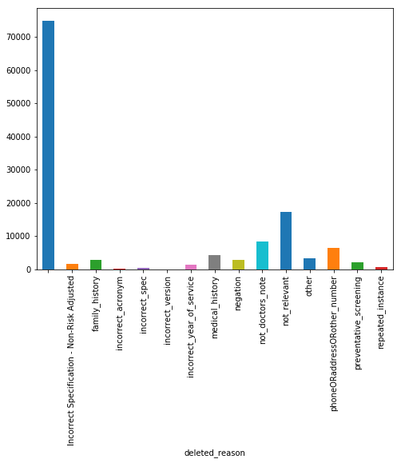
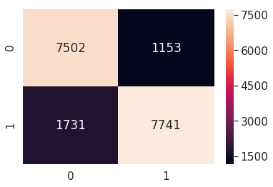
Analytics in RSA AI-Machine Learning
How to use Coder feedback to build the models?
Initial AI will present the diagnosis evidences on UI
Coder review will be labeled as “agreed”(agreed with AI),”added”(AI doesn’t pick up or deleted but it’s actually an evidence) and ”deleted” (AI picked up but need to be deleted)
Based on the labels, a text classifier can be built to help remove the wrongly picked up text/evidence
Three Different models targeted on specific codes/deletion reasons/phrases
Model Accuracy
Different deletion reasons from coder feedback
Pick the ones from the report which deletion models to work on, e.g. family history, negation, medical history etc
Pick certain phrases model like kidney, cancer, diabetes, stroke etc
Pick certain code models like heart, depression, cholesterol etc
0 is keep, 1 is deletion
Test accuracy is 0.8409003144480609
precision recall f1-score support
0 0.87 0.81 0.84 9233
1 0.82 0.87 0.84 8894
Copyright © 2018 Accenture All rights reserved.

Slide 2
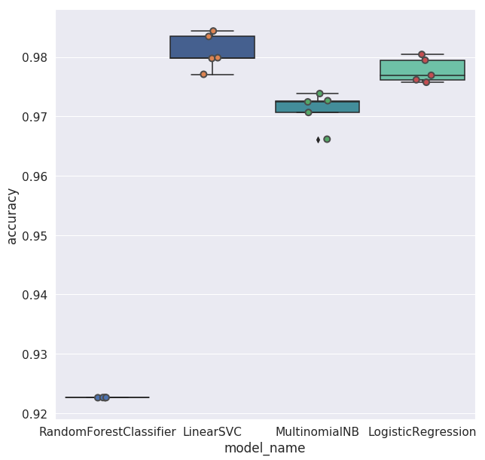
Analytics in RSA AI-Text Classification
Example of the text input
Model building steps
index | text75 | flag
0 | disorder z720 obstructive chronic bronchitis a... | 0
1 | initis j310 cough r05 esophageal reflux k219 h... | 0
2 | initis j310 cough r05 esophageal reflux k219 h... | 0
3 | yperlipidemia e785 mitral regurgitation 1340 m... | 0
4 | yperlipidemia e785 mitral fegurgithtion 1340 m... | 0
Data cleaning or preprocessing using regex and lowercase, remove certain tags, characters, punctuation, stop words etc
Vectorization convert text to numerical features
  CountVectorizer (Bag of Words) word count
  This day is a good day" --> [1, 0, 2, 1, 1, 1, 0]
  TfIdfVectorizer to downscale the frequencies of the words that occur all the time (IDF)
  Using n-gram to provide context
  Can use combination of numeric features like count of
Use classification methods like LogisticRegression, LinearSVM, ensembleRandomForest etc
Comparison of various algorithms with croass validation
Copyright © 2018 Accenture All rights reserved.

Slide 3
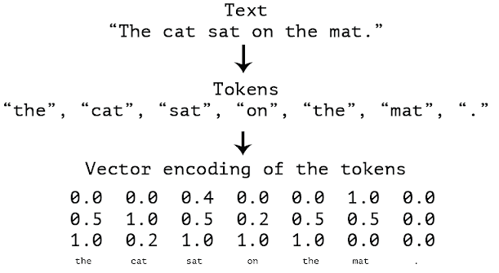
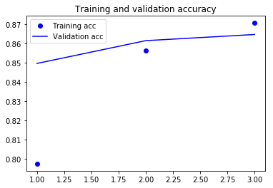
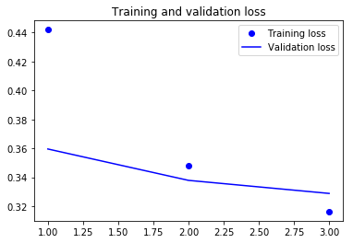
Analytics in RSA AI-Text Classification
Building one consolidated model
We can also just use the previously introduced way to build one model only. But the vectorization does not capture semantics. TF-IDF word vectors are high dimensional if using bi-grams
Using word embeddings to solve word analogies, “A is to B what C is to X”, e.g.
“King — Man + Woman = Queen.” Can use Word2vec, GloVe etc.
. We can use pre-trained word embedding like Glov6B or learn word embedding jointly with the classification by using a deep learning neural network, keras provides Embedding Layer.
There are many different deep learning network architecture like CNN1d, RNN LSTM, CNN1D+LSTM, Attention, TCN etc.
The word embedding to represent the text
The training and validation accuracy/loss versum epochs of training, with word length 70, and embedding dimension=128
Copyright © 2018 Accenture All rights reserved.

Slide 4
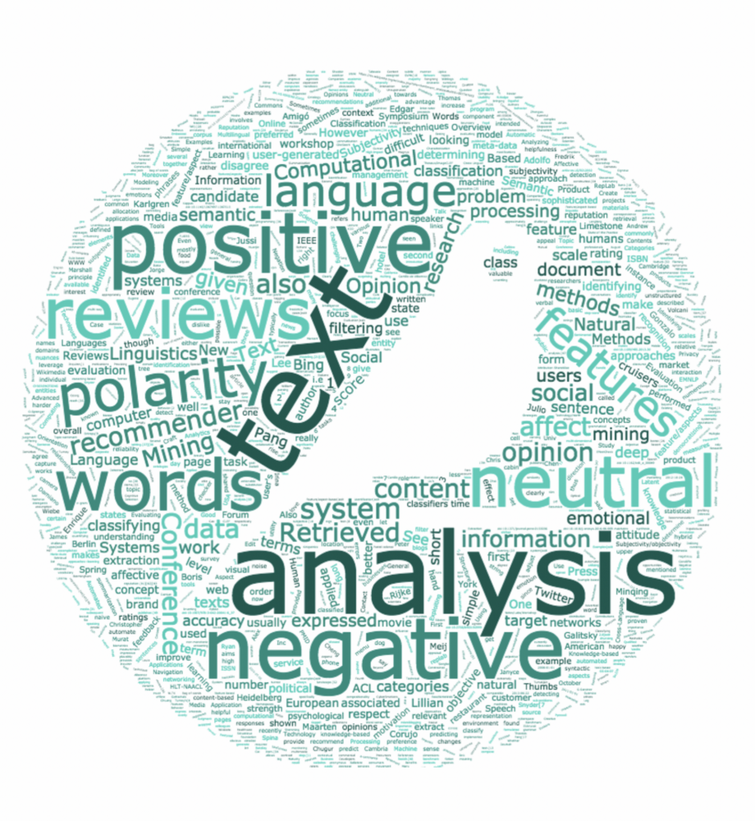
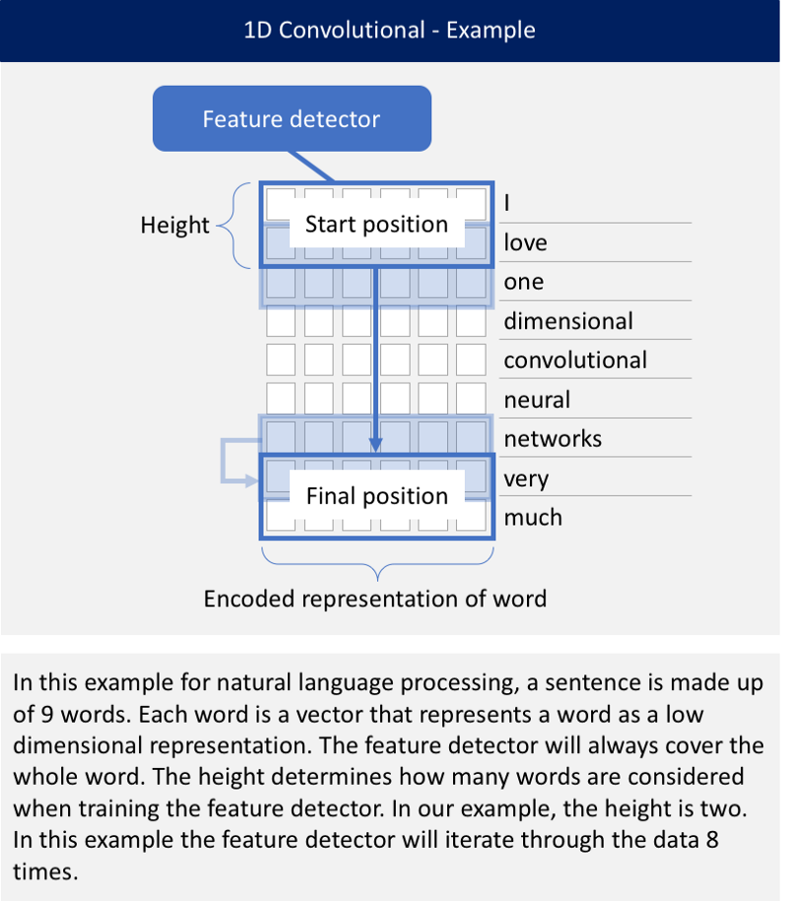
DL NN –CNN1D (convolutional network)
A CNN works well for identifying simple patterns within your data which will then be used to form more complex patterns within higher layers. A 1D CNN is very effective when you expect to derive interesting features from shorter (fixed-length) segments of the overall data set and where the location of the feature within the segment is not of high relevance.
Copyright © 2018 Accenture All rights reserved.
Notes:
TITLE: GLOBAL OIL & GAS MAJOR: ADAPTIVE ANALYTICS OFFER THE LOWDOWN ON UPSTREAM OIL AND GAS
SUMMARY
A global oil and gas major were facing a growing set of challenges with their operations in the Gulf of Mexico. Maintenance was proving inefficient, production deferrals were increasing, and offshore–onshore coordination was often missing. So we helped them establish an Intelligent Remote Operations Center (IROC) to provide a unified real-time view into all subsea and topside operations. Its predictive analytics are helping crews shift toward more preventative maintenance procedures. Its innovative remote collaboration tools mean offshore and onshore teams can now coordinate their work with unprecedented simplicity and ease. It’s helping them optimize production and head off expensive outages before they occur. In fact, within months, production deferrals had already reduced by over 20% – and operating costs by over 12%. It’s taking oil and gas field operations to new heights of performance.
THE CHALLENGE: KEEPING THE OIL AND GAS FLOWING
After years of successful production in the Gulf of Mexico, one global oil and gas major’s rigs were facing a growing number of challenges. A lack of well optimization meant deferrals were increasing. Large numbers of offshore personnel meant operational costs were high and there was little coordination between rigs and onshore teams. Fixed inspections and reactive maintenance procedures meant time was being wasted checking perfectly functional equipment, while opportunities to prevent future asset failures were being missed. The company asked us to help their teams work in a smarter way. But could we develop a single solution to optimize production, improve collaboration, and predict asset failure all at once?
HOW WE HELPED: AN INTELLIGENT REMOTE OPERATIONS CENTER
With an Intelligent Remote Operations Center (IROC) based on a digital foundation platform, we had just the answer. By ingesting the huge amounts of data available across the entire oil and gas value chain into a single platform, we helped provide an unprecedented coordinated real-time view into their subsea and topside operations. And by applying advanced analytics and machine learning to historical operations data, we could train the system to generate new optimization insights and spot potential upcoming asset failures up to several weeks ahead of time. So, whether it was issues with topside drilling equipment, or stuck “pigging” gear (the assets used to clean and monitor pipelines), the system would allow maintenance crews to move in and prevent expensive production outages before they occur. What’s more, thanks to the inclusion of innovative remote advisor functionality in the new platform, crews can communicate from any location during repairs and maintenance work, blending the best of their onshore and offshore expertise in real time.
THE RESULT: WELL POSITIONED FOR HIGH PERFORMANCE
This oil and gas major are now well positioned for the next phase of operations in the Gulf of Mexico. Thanks to vastly improved real-time remote collaboration, they’ve been able to find an ideal balance of offshore and onshore expertise – and transfer over 15% of their rig employees back to the onshore IROC. With fewer people offshore, rig operations are safer and more efficient. And thanks to the IROC’s cutting-edge predictive maintenance insights, they’re also far more productive. In fact, production deferrals reduced by over 20% – and operating costs fell by over 12% – within several months of setting up the IROC. It’s a new adaptive way to bring the best from a human and machine workforce – and it’s taking oil and gas field operations to new heights of performance.

Slide 5
DL NN –LSTM, attention, TCN for
sequence problems
The attention mechanism is a technique inspired from the need to allow the decoder part of the above-mentioned RNN-based framework to use the last hidden state along with information (i.e., context vector) calculated based on the input hidden state sequence. This is particularly beneficial for tasks that require some alignment to occur between the input and output text.
‘Temporal convolutional network’ (TCN) architecture, is inspired by Wavenet and other recent innovations) against sequence modeling architectures like Recurrent Nets (via LSTMs and GRUs). The advantages of TCNs for sequence modeling are as follows: easily parallelizable rather than relying on sequential processing; a flexible receptive field size; stable gradients; low memory requirements for training; and variable length inputs. Disadvantages include: a greater data storage need than RNNs; parameters need to be fiddled with when shifting into different data domains.
RNNs are specialized neural-based approaches that are effective at processing sequential information. An RNN recursively applies a computation to every instance of an input sequence conditioned on the previous computed results. These sequences are typically represented by a fixed-size vector of tokens which are fed sequentially (one by one) to a recurrent unit.
An LSTM consist of three gates (input, forget, and output gates), and calculate the hidden state through a combination of the three. GRUs are similar to LSTMs but consist of only two gates and are more efficient because they are less complex.
Copyright © 2018 Accenture All rights reserved.
Notes:
TITLE: GLOBAL OIL & GAS MAJOR: ADAPTIVE ANALYTICS OFFER THE LOWDOWN ON UPSTREAM OIL AND GAS
SUMMARY
A global oil and gas major were facing a growing set of challenges with their operations in the Gulf of Mexico. Maintenance was proving inefficient, production deferrals were increasing, and offshore–onshore coordination was often missing. So we helped them establish an Intelligent Remote Operations Center (IROC) to provide a unified real-time view into all subsea and topside operations. Its predictive analytics are helping crews shift toward more preventative maintenance procedures. Its innovative remote collaboration tools mean offshore and onshore teams can now coordinate their work with unprecedented simplicity and ease. It’s helping them optimize production and head off expensive outages before they occur. In fact, within months, production deferrals had already reduced by over 20% – and operating costs by over 12%. It’s taking oil and gas field operations to new heights of performance.
THE CHALLENGE: KEEPING THE OIL AND GAS FLOWING
After years of successful production in the Gulf of Mexico, one global oil and gas major’s rigs were facing a growing number of challenges. A lack of well optimization meant deferrals were increasing. Large numbers of offshore personnel meant operational costs were high and there was little coordination between rigs and onshore teams. Fixed inspections and reactive maintenance procedures meant time was being wasted checking perfectly functional equipment, while opportunities to prevent future asset failures were being missed. The company asked us to help their teams work in a smarter way. But could we develop a single solution to optimize production, improve collaboration, and predict asset failure all at once?
HOW WE HELPED: AN INTELLIGENT REMOTE OPERATIONS CENTER
With an Intelligent Remote Operations Center (IROC) based on a digital foundation platform, we had just the answer. By ingesting the huge amounts of data available across the entire oil and gas value chain into a single platform, we helped provide an unprecedented coordinated real-time view into their subsea and topside operations. And by applying advanced analytics and machine learning to historical operations data, we could train the system to generate new optimization insights and spot potential upcoming asset failures up to several weeks ahead of time. So, whether it was issues with topside drilling equipment, or stuck “pigging” gear (the assets used to clean and monitor pipelines), the system would allow maintenance crews to move in and prevent expensive production outages before they occur. What’s more, thanks to the inclusion of innovative remote advisor functionality in the new platform, crews can communicate from any location during repairs and maintenance work, blending the best of their onshore and offshore expertise in real time.
THE RESULT: WELL POSITIONED FOR HIGH PERFORMANCE
This oil and gas major are now well positioned for the next phase of operations in the Gulf of Mexico. Thanks to vastly improved real-time remote collaboration, they’ve been able to find an ideal balance of offshore and onshore expertise – and transfer over 15% of their rig employees back to the onshore IROC. With fewer people offshore, rig operations are safer and more efficient. And thanks to the IROC’s cutting-edge predictive maintenance insights, they’re also far more productive. In fact, production deferrals reduced by over 20% – and operating costs fell by over 12% – within several months of setting up the IROC. It’s a new adaptive way to bring the best from a human and machine workforce – and it’s taking oil and gas field operations to new heights of performance.

